Slide 1
Comparing Cybercrime indexes: Criminal Markets and Drug Trade
These are two of the latest cybercrimes, and we used an interactive graph to compare and contrast which countries have the most occurrences.

Slide 2
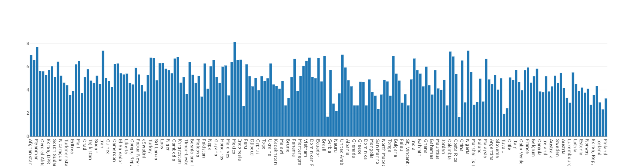
Criminal Markets: 2023
Countries with the highest index: Mexico, Myanmar, Iran, Nigeria, Colombia

Slide 3
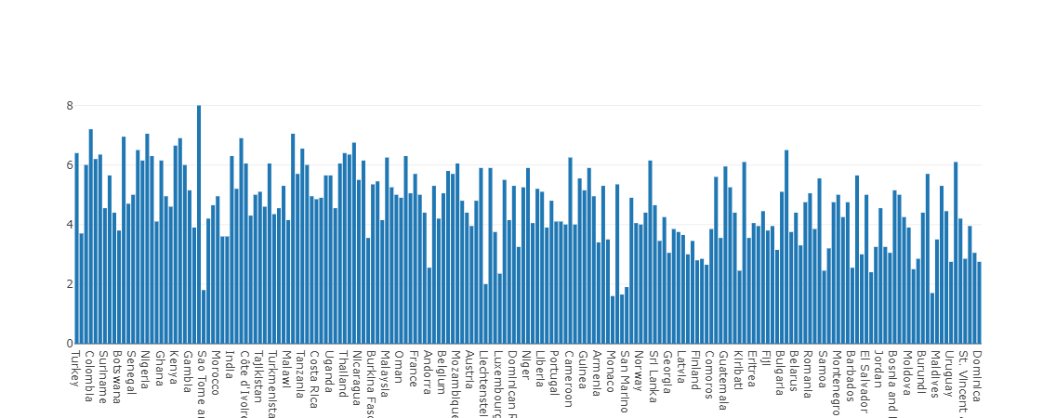
Criminal Markets: 2021
Countries with the highest index: Mexico, Colombia, Myanmar, Nigeria

Slide 4
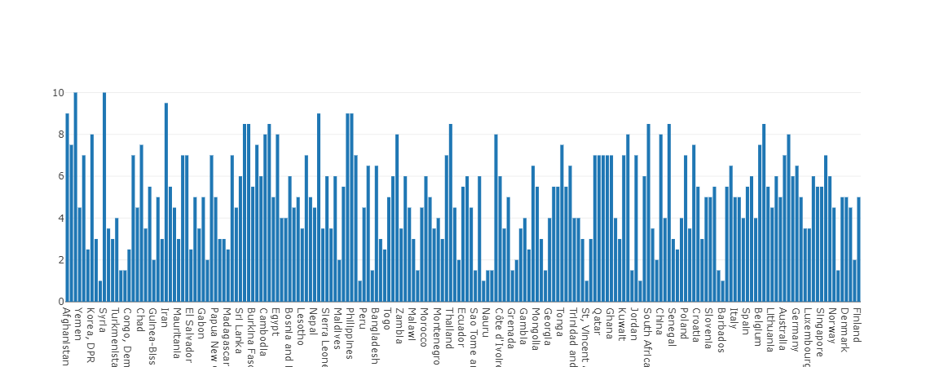
Drug Trade: 2023
Countries with the highest index: Myanmar, Syria, Iran, Afghanistan, Mexico

Slide 5
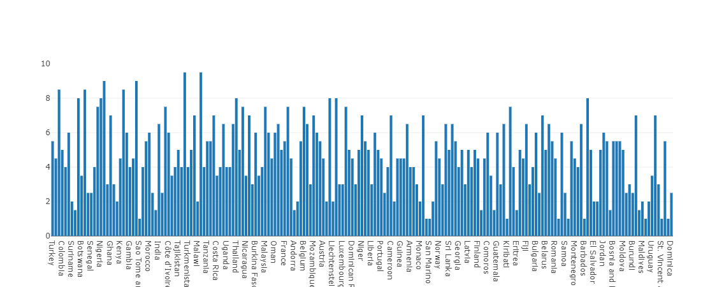
Drug Trade: 2021
Countries with the highest index: Myanmar, Syria, Mexico, Philippines, Afghanistan

